Slide 1
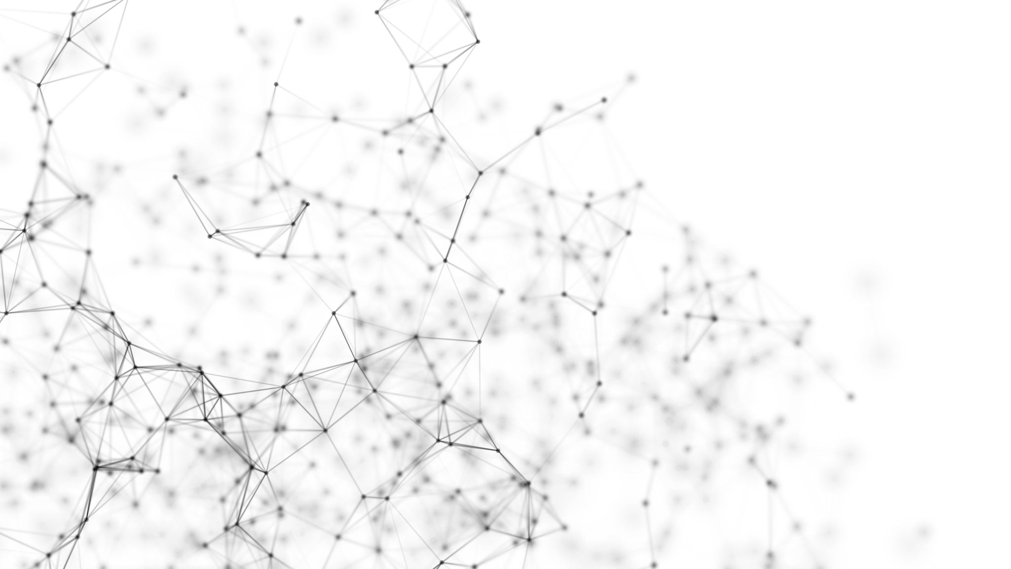
Artificial Neural Networks

Slide 2
Artificial Neural Networks
At earlier times, the conventional computers incorporated algorithmic approach that is the computer used to follow a set of instructions to solve a problem unless those specific steps need that the computer need to follow are known the computer cannot solve a problem.
So, obviously, a person is needed in order to solve the problems or someone who can provide instructions to the computer so as to how to solve that particular problem.
It actually restricted the problem-solving capacity of conventional computers to problems that we already understand and know how to solve.
But what about those problems whose answers are not clear, so that is where our traditional approach face failure and so Neural Networks came into existence.
Neural Networks processes information in a similar way the human brain does, and these networks actually learn from examples, you cannot program them to perform a specific task.

Slide 3
They will learn only from past experiences as well as examples, which is why you don't need to provide all the information regarding any specific task.
So, that was the main reason why neural networks came into existence.
Artificial Neural Network is biologically inspired by the neural network, which constitutes after the human brain.
Neural networks are modeled in accordance with the human brain so as to imitate their functionality.
The human brain can be defined as a neural network that is made up of several neurons, so is the Artificial Neural Network is made of numerous perceptron.

Slide 4

A neural network comprises of three main layers, which are as follows:
Input layer: The input layer accepts all the inputs that are provided by the programmer.
Hidden layer: In between the input and output layer, there is a set of hidden layers on which computations are performed that further results in the output.
Output layer: After the input layer undergoes a series of transformations while passing through the hidden layer, it results in output that is delivered by the output layer.

Slide 5
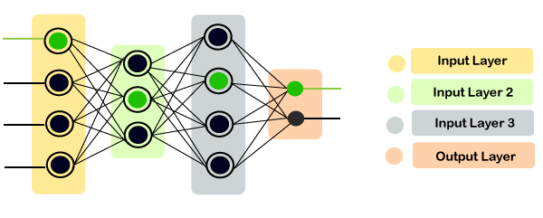

Slide 6
Motivation behind Neural Network
Basically, the neural network is based on the neurons, which are nothing but the brain cells.
A biological neuron receives input from other sources, combines them in some way, followed by performing a nonlinear operation on the result, and the output is the final result.
The dendrites will act as a receiver that receives signals from other neurons, which are then passed on to the cell body.
The cell body will perform some operations that can be a summation, multiplication, etc.
After the operations are performed on the set of input, then they are transferred to the next neuron via axion, which is the transmitter of the signal for the neuron.

Slide 7
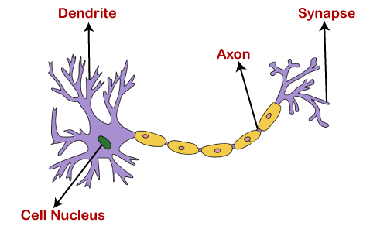

Slide 8
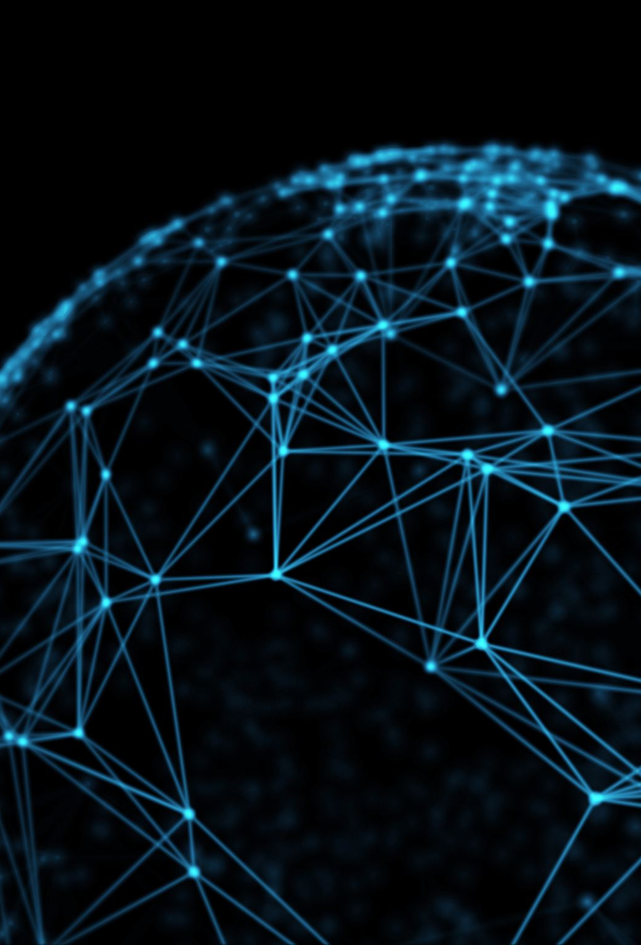
What are Artificial Neural Networks?
Artificial Neural Networks are the computing system that is designed to simulate the way the human brain analyzes and processes the information.
Artificial Neural Networks have self-learning capabilities that enable it to produce a better result as more data become available.
So, if the network is trained on more data, it will be more accurate because these neural networks learn from the examples.
The neural network can be configured for specific applications like data classification, pattern recognition, etc.
With the help of the neural network, we can actually see that a lot of technology has been evolved from translating webpages to other languages to having a virtual assistant to order groceries online.
All of these things are possible because of neural networks. So, an artificial neural network is nothing but a network of various artificial neurons.

Slide 9
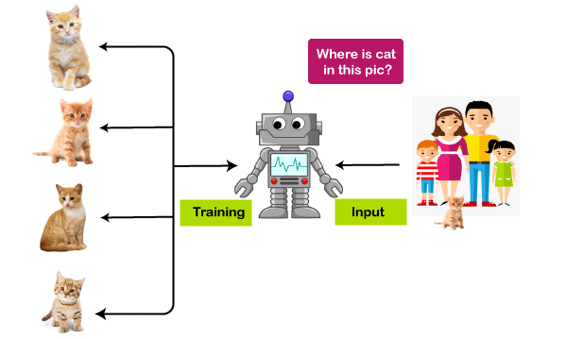
Importance of Neural Network:
Without Neural Network:
Let's have a look at the example given below.
Here we have a machine, such that we have trained it with four types of cats, as you can see in the image below.
And once we are done with the training, we will provide a random image to that particular machine that has a cat.
Since this cat is not similar to the cats through which we have trained our system, so without the neural network, our machine would not identify the cat in the picture.
Basically, the machine will get confused in figuring out where the cat is.

Slide 10

With Neural Network:
However, when we talk about the case with a neural network, even if we have not trained our machine with that particular cat.
But still, it can identify certain features of a cat that we have trained on, and it can match those features with the cat that is there in that particular image and can also identify the cat.
So, with the help of this example, you can clearly see the importance of the concept of a neural network.

